Slide 1
Data Stream Pipeline Project
Author name: Hamza Rakkabi
Author title: Software Test and Automation Engineer
Company: STMicroelectronics Morocco
Publication date: 3/7/2022

Slide 2

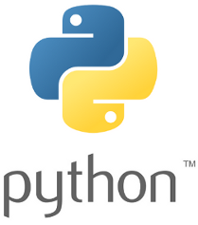

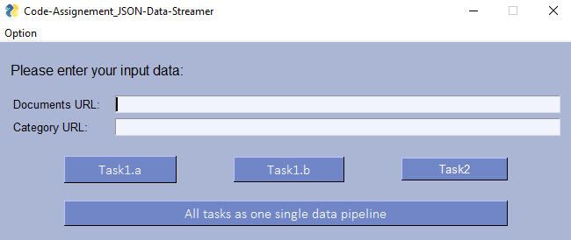
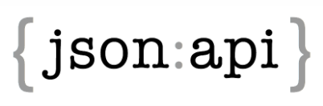
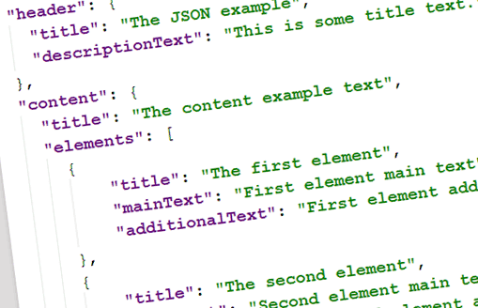
Application Architecture Technical details
Project purpose and workflow:
This project is originally a coding assignment which help to build a simple data “pipeline” from input:
Extracts JSON data from a ReST API
Transforms the data
Stores the data and performs a simple evaluation on that data
INPUT
PROCESSING
OUTPUT
Documents
Category
Information Extraction
Saved file
Data Pre-processing

Slide 3
Application Architecture Technical details
Front-End: PySimpleGUI library
GENERAL INFORMATIONS:
OS Working space: Windows 10 x64amd
Programming Framework: Python 3.9
IDE Programming: Spyder 4.2.5
Testing framework: PyTest
Python added modules:
JSON
PYTEST
PANDA
JSON SCHEMA
PYSIMPLEGUI
Back-End: JSON library, Panda library, JSON Schema library
Python Kernel: OS library, Re library

Slide 4
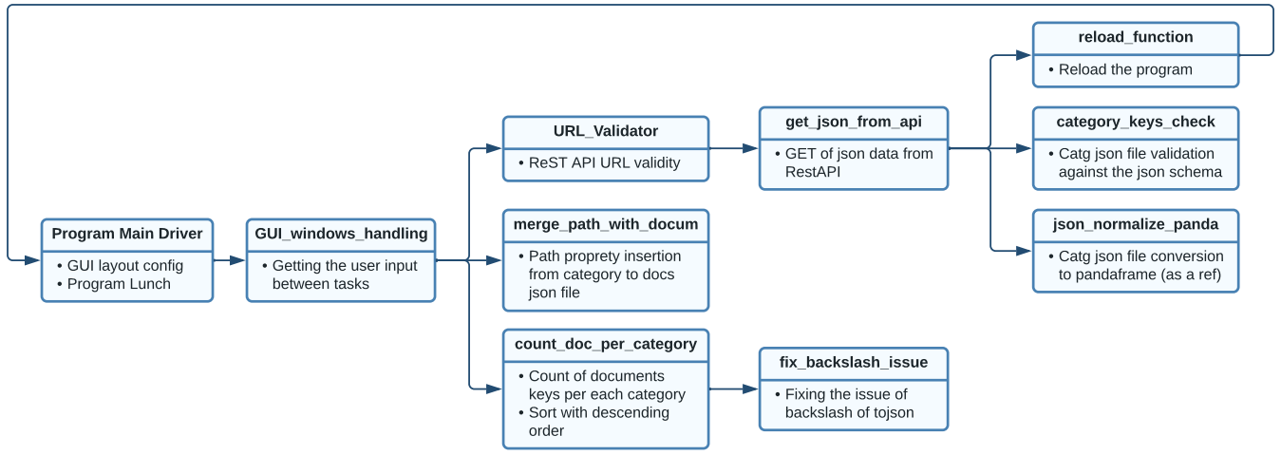
Application Architecture Code Source Structure
Below is an UML model of descriping the level of dependency of each function inside the source code of the application provided:

